Slide 1

Predicting Depression in Students
Kashaf Shakoor MSDS-110

Slide 2
Objectives
To predict student depression using machine learning techniques.
Steps:
Exploratory Data Analysis (EDA)
Data Preprocessing
Model Selection and Evaluation
Insights and Conclusions

Slide 3
Data Overview
Dataset: Depression Student Dataset.csv
Columns include numeric and categorical data.
Summary statistics and dataset shape.

Slide 4
Data Exploration
Code used to check missing values.
Overview of identified missing data (if any).
Plan for handling missing values.

Slide 5
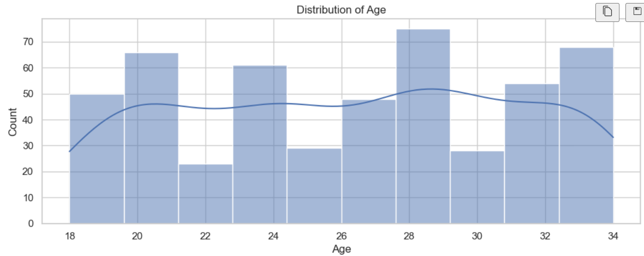
Data Visualization
Numeric Data Analysis
Content:
Histograms of numeric variables.
Observations: Data distributions, skewness, or outliers.

Slide 6
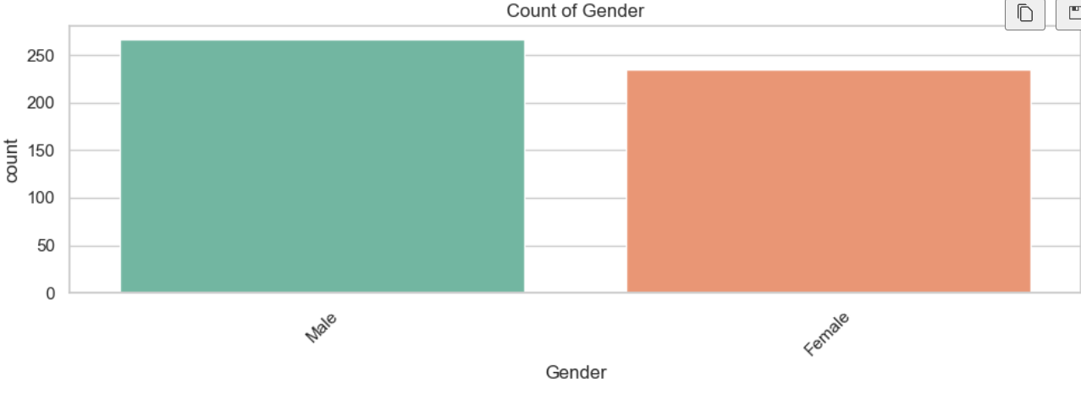
Categorical Data Visualization
Categorical Data Analysis
Content:
Bar plots showing frequency distribution of categorical variables.
Key patterns observed in categories.

Slide 7
Preprocessing
Data Preprocessing Techniques
Content:
Encoding techniques: Label encoding .
Train-test split (include code or percentages used).

Slide 8
Machine Learning Models
Models Implemented
Decision Tree Classifier
K-Nearest Neighbors (KNN)
Random Forest Classifier
Steps to train and evaluate models.

Slide 9
Evaluation Metrics
Model Evaluation
Metrics: Accuracy, confusion matrix, classification report.
Best-performing model based on evaluation results.

Slide 10
Thank you

